Slide 1

Cross-Validation & Forecasting
Dr. Abolfazl Saghafi
Assistant Professor of Statistics & Data Science
Notes:
We continue this week by cross-validation and forecasting after a short overview of what is discussed so far

Slide 2


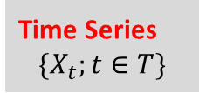







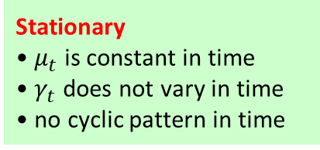


ACF
$${\hat{φ}\left(B\right) Y}_{t}=\hat{θ}\left(B\right)$$
Residual Analysis
• Zero Mean
• Constant Variance
• Randomness
• Normality
Stationary
• $μ_{t}$ is constant in time
• $γ_{t}$ does not vary in time
• no cyclic pattern in time
$$Y_{t}$$
Probabilistic Models
• ARMA(p,q)
PACF
Forecasting
• CV
• Future Values
Time Series
$$\{X_{t};t∈T\}$$
$$X_{t}$$
$$Y_{t}$$
$$Y_{t}=$$
$$X_{t}−$$
$${\hat{μ}}_{t}$$
Variation Change
• Box-Cox Transformation
Trend
• Regression
• Moving Average
• Differencing
$$Y_{t}=$$
$$X_{t}−$$
$${\hat{s}}_{t}$$
Stationarity
• ARIMA(p,d,q)
Seasonality
• Averaging
• Regression
• Lagged-Differencing
$$X_{t}$$
Non-Stationary
Notes:
A quick overview of the process. Time series are either stationary or non-stationary. If we have a time series $X_{t}$ that is non-stationary due to changing variation and non-constant variance in time, we could use Box-Cox transformation to transform $X_{t}$ into $Y_{t}$ with fixed variation. If time series $X_{t}$ has a trend, we could estimate the trend using regression or moving averaging and then subtract the estimation from $X_{t}$ to achieve $Y_{t}$ with no trend. We could also do differencing that removes the trend. If time series $X_{t}$ has seasonal variation, we could estimate the frequency and seasonal variation by averaging or regression and then subtract the estimation from $X_{t}$ to achieve $Y_{t}$ with no seasonal variation. We could also do differencing of lag equal to frequency of cycles to remove seasonal variation. It is also important to note that, often times, when we do differencing of certain lags to remove seasonality, we also remove trends.
Now that we have a stationary time series, lets call it $Y_{t}$, we can investigate its ACF/PACF to fit ARMA(p,q) models to the time series. The model is reliable only after residual analysis and verifying four assumptions. Once the assumptions are verified, the time series can be used for forecasting. It is best to perform cross-validation for model selection.
If stationarity has been achieved through differencing, we can fit ARIMA(p,d,q) models to time series $X_{t}$. Let’s follow this process up with an example.

Slide 3
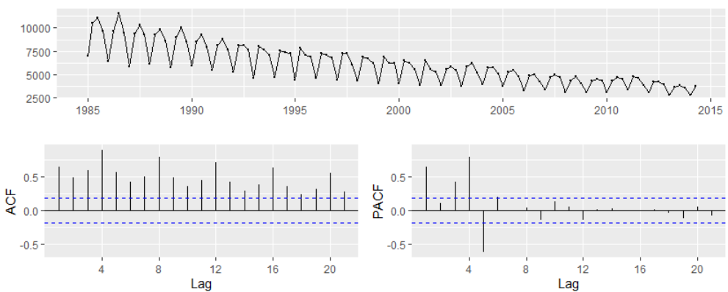

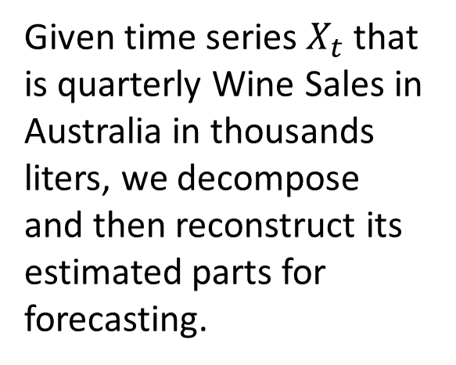
Example 1
Given time series $X_{t}$ that is quarterly Wine Sales in Australia in thousands liters, we decompose and then reconstruct its estimated parts for forecasting.
❶ The time plot shows a nonstationary time series that has a downward trend and seasonal variation. The variance seems to be constant in time.
❷ Order 1 differencing of lag 4 removes the seasonal variation with frequency four and a linear trend. Therefore, the new time series after this differencing is
$$Y_{t}=∇_{4}X_{t}=X_{t}−X_{t−4}$$
Notes:
Looking at the data, we have quarterly wine sales, so it’s reasonable for the frequency to be 4. We can verify this, there are 118 observations and 29 peaks, therefore, frequency is 4. The time series has trend and seasonal variation, we need to remove them. We can estimate the trend and remove it, then estimate the seasonal variation and remove it using regression techniques. Or we can perform order 1 differencing of lag 4 that removes the seasonal variation with frequency 4 AND a linear trend. Therefore, the new time series after this differencing is $Y_{t}$

Slide 4
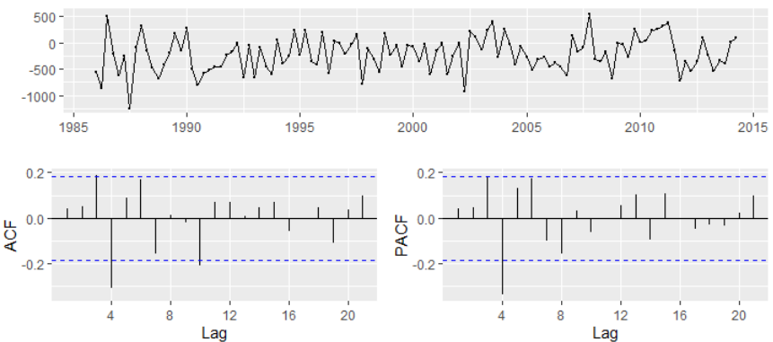
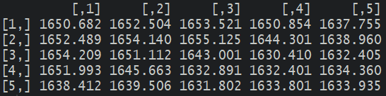

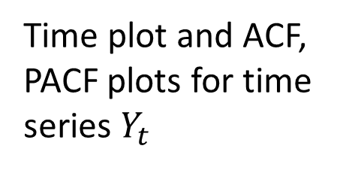
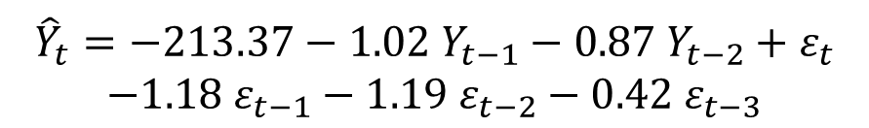

Time plot and ACF, PACF plots for time series $Y_{t}$
❶ The time plot shows a stationary time series that fluctuates around -200.
❷ The ACF/PACF plots do not clearly suggest an ARMA model, so we fit multiple ARMA models:
ARMA(2,3) has the smallest AIC
❸ After fitting ARMA(2,3), $Y_{t}$ is estimated as
$${\hat{Y}}_{t}=−213.37−1.02 Y_{t−1}−0.87 Y_{t−2}+ε_{t}$$
$$−1.18 ε_{t−1}−1.19 ε_{t−2}−0.42{ ε}_{t−3}$$
Notes:
This is the time plot and ACF, PACF plots for time series $Y_{t}$.
Pay attention that the fitted model includes intercept since the time series fluctuates around -200 not 0.
We introduced MA(q) as $X_{t}=ε_{t}{−θ}_{1}ε_{t−1}{−…−θ}_{q}ε_{t−q}$ which is a standard formulation in many literatures. Some literatures, such as the forecast package that is used in R utilizes $X_{t}=ε_{t}{+θ}_{1}ε_{t−1}{+…+θ}_{q}ε_{t−q}$ which does look easier to follow up BUT it creates complications in in finding characteristic polynomial roots.

Slide 5
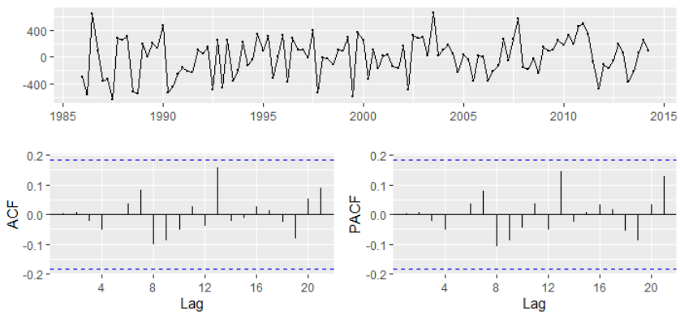
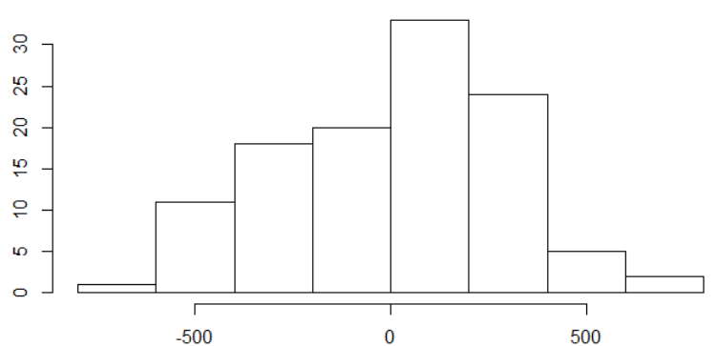
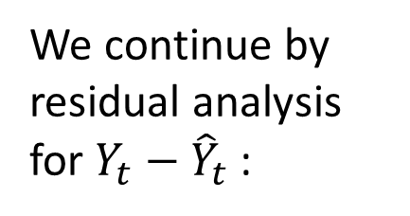

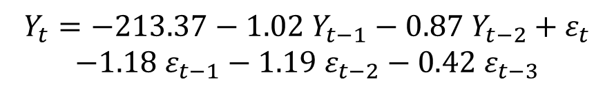
We continue by residual analysis for $Y_{t}−{\hat{Y}}_{t}$ :
❶ Zero Mean
❷ Fixed Variability
❸ Random fluctuations
❹ Normality
In the end, our model is
$$Y_{t}=X_{t}−X_{t−4}$$
$$Y_{t}=−213.37−1.02 Y_{t−1}−0.87 Y_{t−2}+ε_{t}$$
$$−1.18 ε_{t−1}−1.19{ ε}_{t−2}−0.42 ε_{t−3}$$
Notes:
Let’s see how to perform forecasting

Slide 6
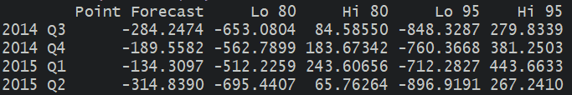
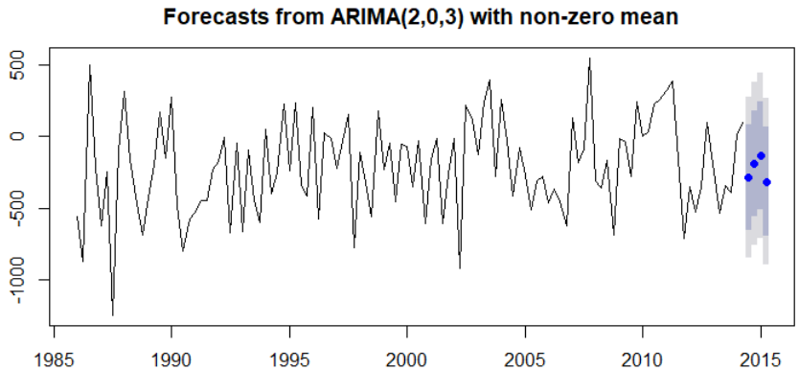





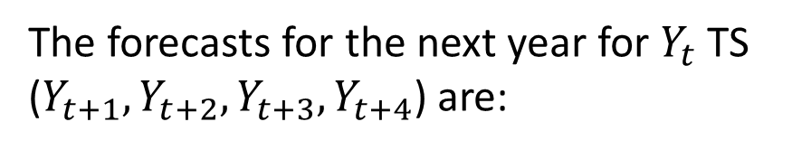




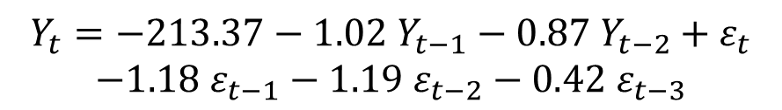
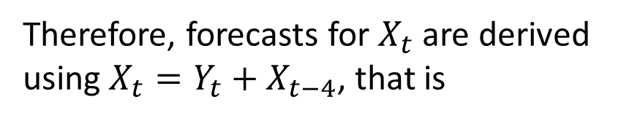

We concluded this model for our $X_{t}$ TS:
$$Y_{t}=X_{t}−X_{t−4}$$
$$Y_{t}=−213.37−1.02 Y_{t−1}−0.87 Y_{t−2}+ε_{t}$$
$$−1.18 ε_{t−1}−1.19{ ε}_{t−2}−0.42{ ε}_{t−3}$$
The forecasts for the next year for $Y_{t}$ TS ($Y_{t+1},Y_{t+2},Y_{t+3},Y_{t+4}$) are:
Therefore, forecasts for $X_{t}$ are derived using $X_{t}=Y_{t}+X_{t−4}$, that is
$X_{t+1}=Y_{t+1}+X_{t−3}$
$$=3709.75$$
$X_{t+2}=Y_{t+2}+X_{t−2}$
$$=3662.69$$
$X_{t+3}=Y_{t+3}+X_{t−1}$
$$=2702.69$$
$X_{t+4}=Y_{t+4}+X_{t}$
$$=3482.16$$
Notes:
To forecast, we use the estimated equation of the model, compute value of the time series at the next time step, that is for time (t+1), you can see in the formula that it is quite easy, for $ε_{t+1}$ use zero, for other moving average parts use past residuals from the estimated model. There is a command that does that automatically, here are the forecasts for the next four time steps. We can also generate a plot that shows 80% and 95% confidence intervals.
It’s important to note that the confidence intervals are reliable as long as the residuals of the model have a normal distribution, if this assumption is violated, the CI’s are not reliable. Hers is the forecasts shown in a time plot of $Y_{t}$.
These were forecasts for $Y_{t}$, we can simply transform them to reflect $X_{t}$ forecasts by inversing that lag 4 difference, that is by using a lag 4 summation. Therefore,

Slide 7
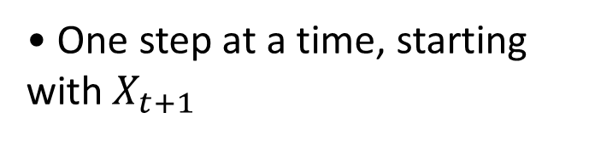
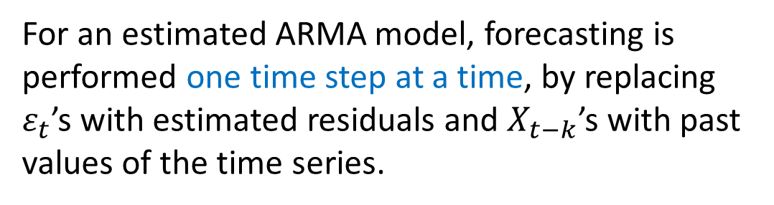
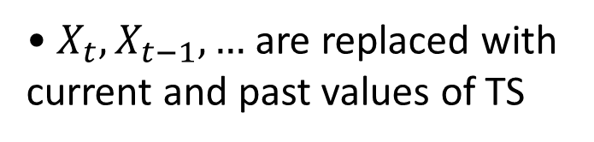
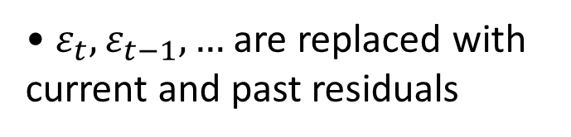
Forecasting
Forecasting
• One step at a time, starting with $X_{t+1}$
One of the primary objectives of building a model for a time series is to be able to forecast the values for that series at future times.
• $ε_{t},ε_{t−1},…$ are replaced with current and past residuals
• $X_{t},X_{t−1}, …$ are replaced with current and past values of TS
Of equal importance is the assessment of the precision of those forecasts.
For an estimated ARMA model, forecasting is performed one time step at a time, by replacing $ε_{t}$’s with estimated residuals and $X_{t−k}$’s with past values of the time series.
Cross-Validation technique is used for identifying the best model for forecasting purposes. They provide a measure of how good the model forecasts.
To provide forecast for the initial time series, other existing components (differencing, trend, seasonal variation) are then added back to the time series.
Notes:
$ε_{t+k}$’s are replaced with 0, that is the mean of the white noise time series.
What is cross-validation?

Slide 8
Cross Validation
• Cross Validation is performed prior to parameter estimation for a stationary time series
To avoid overﬁtting and be able to assess the predictive performance of a model, we ﬁrst partition the data into a training and a test set.
• These steps are performed for probabilistic modeling
• A model that performs better in test set and equally well on training set is favorable.
• The first 90% of time series data is assigned to training set that is used to estimate parameters of a stationary model.
• Predictive performance of the models is assessed on the test set.
• Some performance measurements are Mean Squared Error (MSE), Mean Absolute Error (MAE), and Mean Absolute Percentage Error (MAPE) of observations in test set and their predictions using trained model on training set.
• Once a model is selected based on goodness of fit measures, train and test sets are mixed to re-estimate model parameters and to provide future forecasts.
Notes:
At ﬁrst glance, we might think it best to choose a model that generates the best forecasts on the data series at hand. However, when we use the same data both to develop the forecasting model and to assess its performance, we introduce bias.

Slide 9
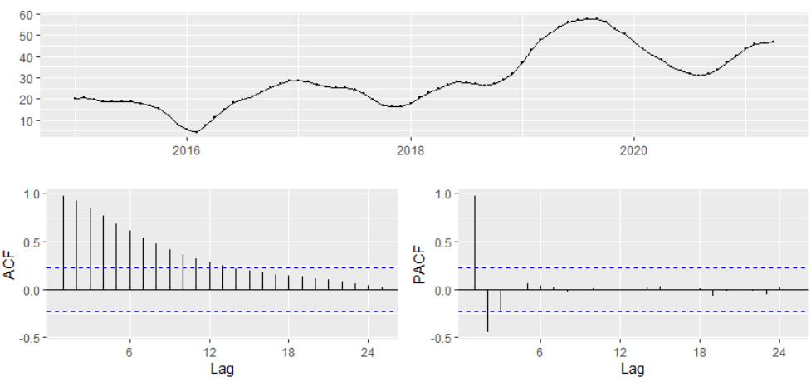
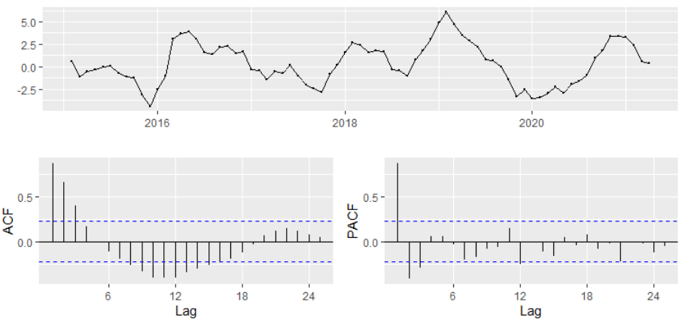
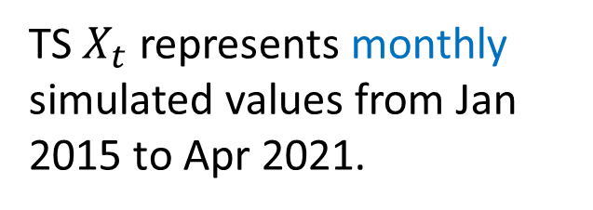
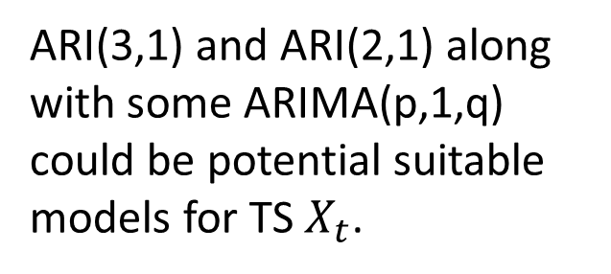
Example 2
TS $X_{t}$ represents monthly simulated values from Jan 2015 to Apr 2021.
Obviously a Non-stationary TS with a trend.
Order 1 differencing could generate a stationary TS.
ARI(3,1) and ARI(2,1) along with some ARIMA(p,1,q) could be potential suitable models for TS $X_{t}$.
Notes:
Here we see an example where several models with roughly the same AIC values, fitting the time series data well. In here, TS $X_{t}$ represents monthly simulated values from Jan 2015 to Apr 2021.
Obviously, we have a non-stationary TS with a trend. Order 1 differencing could generate a stationary TS, you see how we reach a stationary TS after one-time differencing.
Therefore, ARI(3,1) and ARI(2,1) along with some ARIMA(p,1,q) could be potential suitable models for the original $X_{t}$ TS.

Slide 10
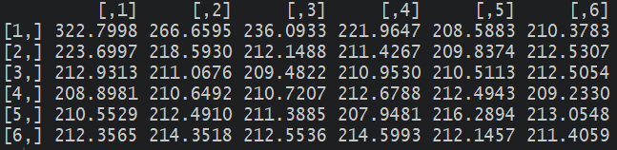
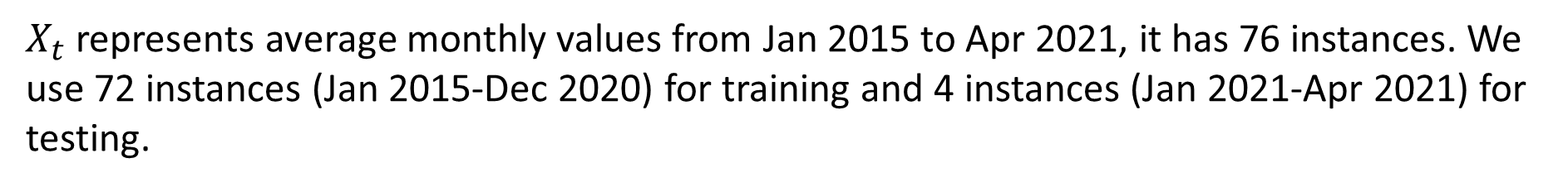
$X_{t}$ represents average monthly values from Jan 2015 to Apr 2021, it has 76 instances. We use 72 instances (Jan 2015-Dec 2020) for training and 4 instances (Jan 2021-Apr 2021) for testing.
Train: sim.ts[1:72]
[73:76]
Then we proceed by fitting several ARIMA models to the training data. The AIC values are:
We then rank models in terms of their AIC, best four models and their number of parameters are:
Rank Model AIC (p+q)
1st ARIMA(4,1,3) 207.95 7
2nd ARIMA(0,1,4) 208.59 4
3rd ARIMA(3,1,0) 208.90 4
4th ARIMA(3,1,5) 209.23 8
AIC values are very close but there are two models that have less number of parameters.

Slide 11
We continue by computing AICc and BIC for the top four models:
Rank Model AIC (p+q)
1st ARIMA(4,1,3) 207.95 7
2nd ARIMA(0,1,4) 208.59 4
3rd ARIMA(3,1,0) 208.90 4
4th ARIMA(3,1,5) 209.23 8
AICc BIC
210.27 223.95
209.51 218.59
209.50 216.90
212.18 227.23
MSE MAE MAPE
2.86 1.27 0.0269
1.22 1.06 0.0230
0.18 0.41 0.0090
0.68 0.68 0.0146
The 2nd and 3rd model has nearly the same AICc, the third one has the smallest BIC.
The 3rd model seems to be is the best among alternative fitted models but is it also good in forecasting?
Then, we generated forecasts for the next 4 instances using the fitted model in the training set and computed MSE, MAE, and MAPE between the forecasted values and data in the test set. The performance measurements are given here.
In the end, the third model has a relatively small AIC, the smallest AICc and BIC, it also generates the smallest MSE, MAE, and MAPE. Therefore, we proceed with ARIMA(3,1,0).
Notes:
We continue by computing AICc which is the best GoF measure, also compute BIC. The comparisons show that the 2nd and 3rd model has nearly the same AICc, but the third one has the smallest BIC. The third model seems to be is the best among alternative fitted models but is it also good in forecasting?
Then, we generated forecasts for the next 4 instances using the fitted model in the training set and computed MSE, MAE, and MAPE between the forecasted values and data in the test set. The performance measurements are given here. The third model really stands up as it provided the best forecasts, MSE, MAE, and MAPE are all smallest for the third model.
One last thing before we finalize our decision, we need to perform residual analysis.

Slide 12
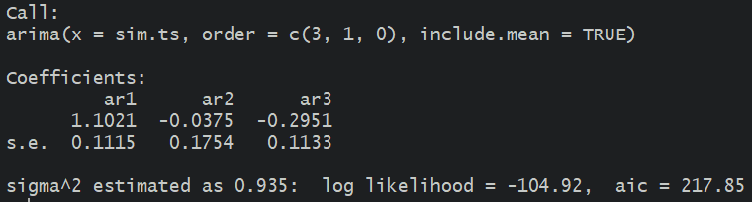
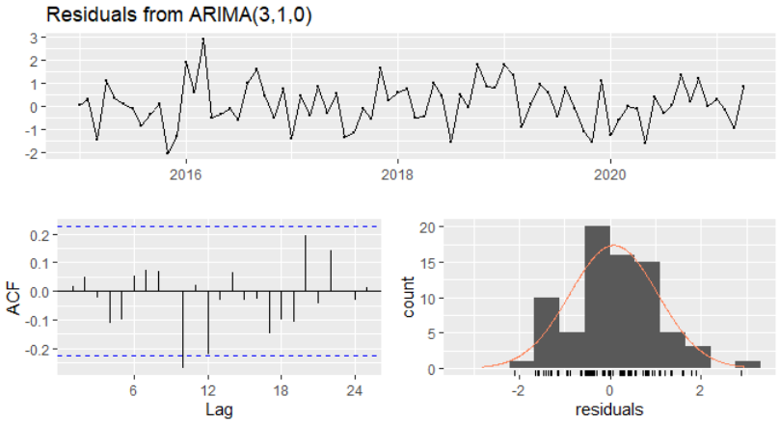
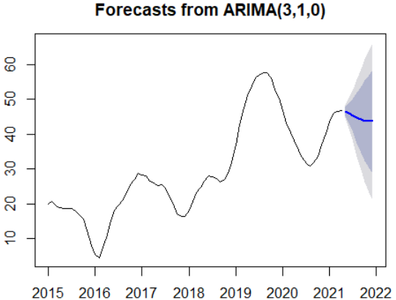
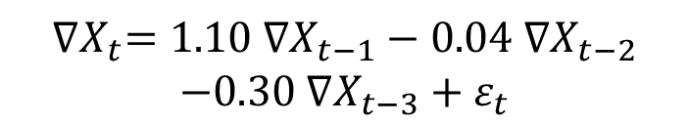
We mix the data in training and test set and fit the 3rd model to the complete data. Estimated model is
$${∇X}_{t}=1.10 ∇X_{t−1}−0.04 ∇X_{t−2}$$
$$−0.30 ∇X_{t−3}+ε_{t}$$
We need to conform residuals satisfy the four required assumption before using model for forecasting:
Residual analysis confirms the four assumptions. Therefore, we proceed by forecasting the next 8 months

Slide 13
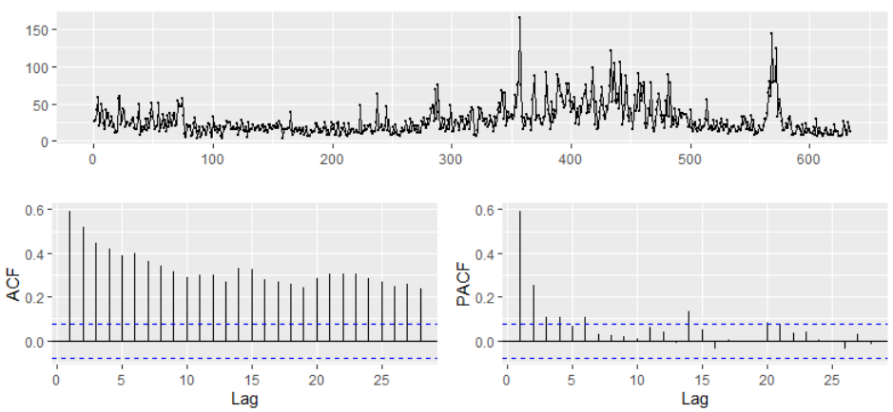
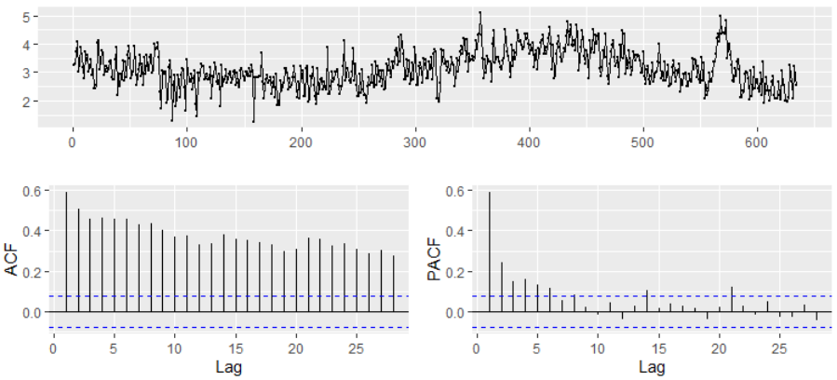
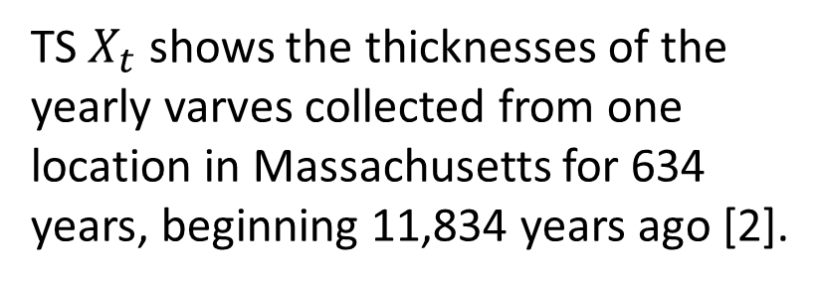
Example 3
TS $X_{t}$ shows the thicknesses of the yearly varves collected from one location in Massachusetts for 634 years, beginning 11,834 years ago [2].
Data shows a non-stationary TS since the variability increases in time. Box-Cox transformation recommends using λ = 0.04 which is close to 0 that corresponds to log transformation.
Data after log-transformation look much nicer but still non-stationary with some trends.
[2] Shumway & Verosub, State space modeling of paleoclimatic time series, Proceeding of 5th Int. Meeting Stat. Climatol., Toronto, June 1992.
Notes:
The same process as example 2 is followed up here to decide on the final model for forecasting

Slide 14
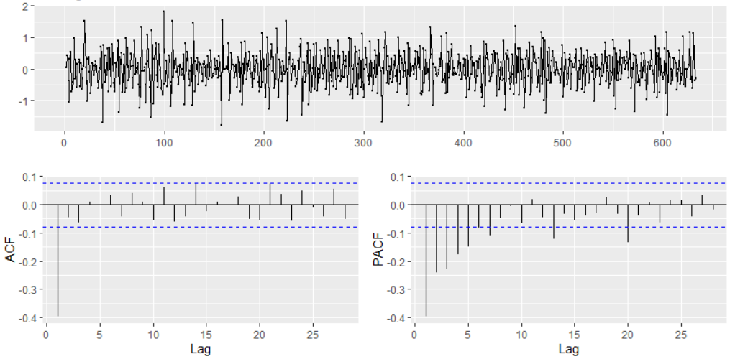
We have a stationary TS after one time differencing of the log transformed data.
Looking at the plots, therefore IMA(1,1) seems like a good fit for the log(varve) data but we proceed by train/test split and investigating several options.
87%-13% train-test split of the Log transformed data:
Train: lvarve[1:550] # 87%
[551:633]
Rank Model AIC (p+q)
1st ARIMA(3,1,3) 730.07 6
2nd ARIMA(1,1,1) 731.66 2
3rd ARIMA(3,1,4) 731.74 7
4th ARIMA(0,1,2) 732.56 2
AICc BIC
730.28 758.07
731.71 743.66
732.01 763.74
732.61 744.56
MSE MAE MAPE
0.519 0.577 0.2099
0.515 0.577 0.2098
0.519 0.577 0.2030
0.515 0.577 0.2098

Slide 15
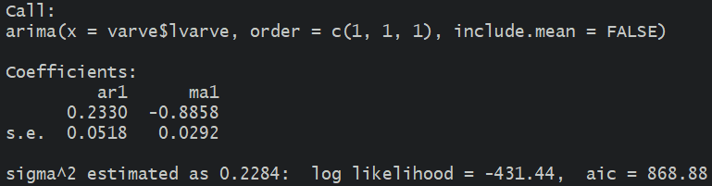
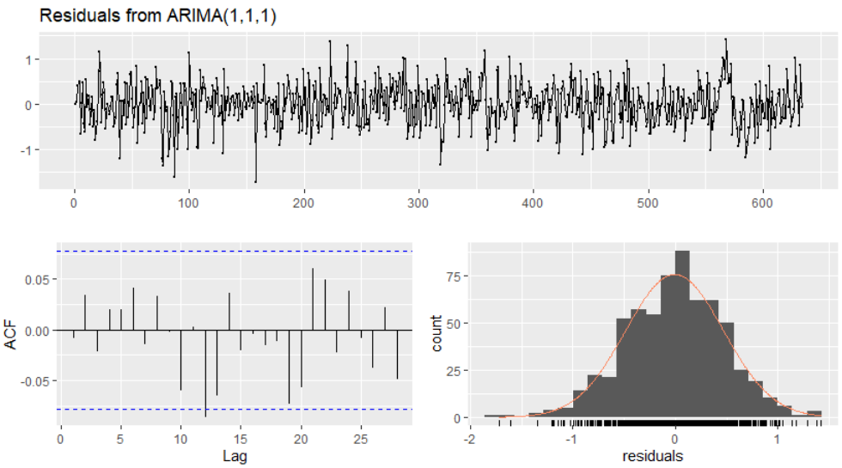
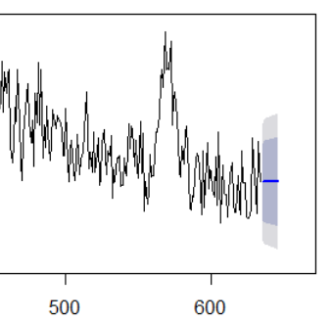
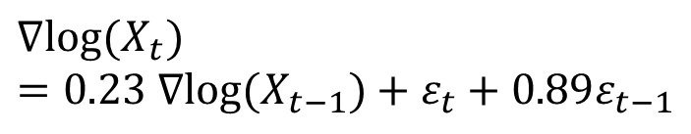
We mix the data in training and test set and fit the 2nd model to the complete data. Estimated model is
$${∇log⁡(X}_{t})=0.23 ∇{log⁡(X}_{t−1})+ε_{t}+0.89ε_{t−1}$$
Residual analysis should be performed. It confirms the four assumptions:
Therefore, we proceed by forecasting the next 12 instances.
Notes:
Ljung-Box test is a test of randomness that is used in the lab sessions

Slide 16
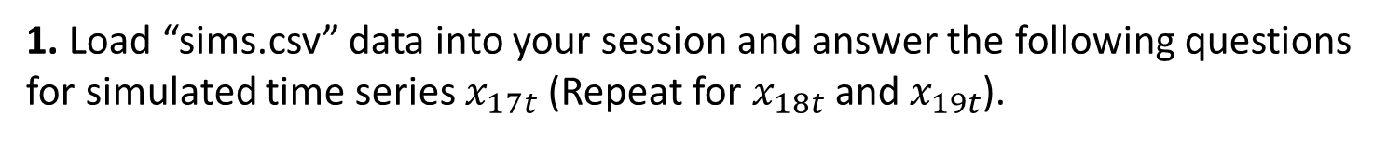
Practice Problems
1. Load “sims.csv” data into your session and answer the following questions for simulated time series $x_{17t}$ (Repeat for $x_{18t}$and $x_{19t}$).
a. Graph the time plot, ACF & PACF plots and investigate stationarity.
b. If the time series is non-stationary, use available techniques to achieve a stationary time series.
c. For the achieved stationary time series, perform cross validation. Decide on three best ARMA(p,q) models using AIC on training set.
d. Calculate AICc and BIC for the three best models and comment.
e. Calculate MSE, MAE, and MAPE by computing forecasts using training set and values in test set. Decide on a final best model using all the evidence.
f. Mix train and test data, refit the best model and estimate model parameters.
g. Perform residual analysis for the residuals of the best model and investigate assumptions.
h. Perform forecasts for the next four instances for the values of the original time series.
Notes:
These are follow ups from last week

Slide 17
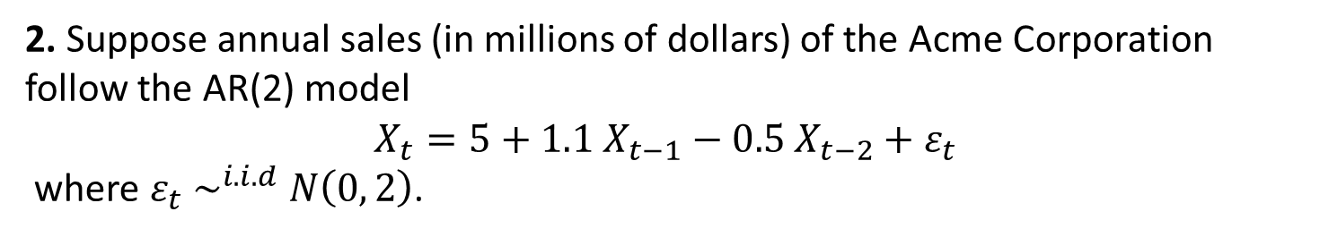
Practice Problems
2. Suppose annual sales (in millions of dollars) of the Acme Corporation follow the AR(2) model
$$X_{t}=5+1.1 X_{t−1}−0.5 X_{t−2}+ε_{t}$$
where $ε_{t} \sim ^{i.i.d} N\left(0, 2\right)$.
a. If sales for 2005, 2006, and 2007 were $9 million, $11 million, and $10 million, respectively, forecast sales for 2008 and 2009.
b. If sales in 2006 turn out to be $12 million, update your forecast for 2007.
3. Perform a train/test split for example 1, fit multiple ARMA models to the differenced data, decide on a best model using MSE/MAE/MAPE. Is the best model the same as the one used in that example for forecasting?

